Slide 1
Software Quality Assurance
/
Software Quality Engineering
Lecture 11
Naseer Ahmed

Slide 2
Bug in Software Testing
The Bug is the informal name of defects, which means that software or application is not working as per the requirement.
In software testing, a software bug can also be issue, error, fault, or failure. The bug occurred when developers made any mistake or error while developing the product.
While testing the application or executing the test cases, the test engineer may not get the expected result as per the requirement. And the bug had various names in different companies such as error, issues, problem, fault, and mistake, etc.

Slide 3
Bug in Software Testing
Basic terminology of defect:
Terms | Description | Raised by
Defect | When the application is not working as per the requirement. | Test Engineer
Bug | Informal name of defect | Test Engineer
Error | Problem in code leads to the errors. | Developer, Automation Test Engineer
Issue | When the application is not meeting the business requirement. | Customer
Mistake | Problem in the document is known as a mistake. | --
Failure | Lots of defect leads to failure of the software. | --

Slide 4
Bug in Software Testing
Why defect/bug occur?
In software testing, the bug can occur for the following reasons:
Wrong coding
Wrong coding means improper implementation.
For example:
Suppose if we take the Gmail application where we click on the "Inbox" link, and it navigates to the "Draft" page, this is happening because of the wrong coding which is done by the developer, that's why it is a bug.

Slide 5
Bug in Software Testing
Why defect/bug occur?
Missing coding:
Here, missing coding means that the developer may not have developed the code only for that particular feature.
For example:
if we take the above example and open the inbox link, we see that it is not there only, which means the feature is not developed only.

Slide 6
Bug in Software Testing
Why defect/bug occur?
Extra coding:
Here, extra coding means that the developers develop the extra features, which are not required according to the client's requirements.
For example:
Suppose we have one application form wherein the Name field, the First name, and Last name textbox are needed to develop according to the client's requirement.
But, the developers also develop the "Middle name" textbox, which is not needed according to the client's requirements

Slide 7
Bug in Software Testing
Bug tracking tool
We have various types of bug tracking tools available in software testing that helps us to track the bug, which is related to the software or the application.
Some of the most commonly used bug tracking tools are as follows:
Jira
Bugzilla
Redmine
Mantis
Backlog

Slide 8
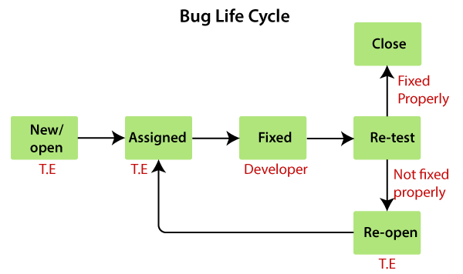
Bug in Software Testing
Bug Life cycle:
the complete life cycle of a bug from the stage it was found, fixed, re-test, and close.
We have some different status of bugs like new/open, assigned, fix, re-open, and closed.

Slide 9
Bug in Software Testing
Bug Life cycle: Whom to assign the bug:
The bug can be assigned to the following:
Developers
Developers lead
Test lead
Developers: If we know who has developed that particular module.
Developer lead: If we don't know the Developer who has developed the particular module.
Test lead: When we don't have any interaction with the development team.

Slide 10
Bug in Software Testing
Bug Life cycle: Another status of the bug:
Once we prepared a bug report and send it to the Developers, the Developer will accept the bug and starts doing the necessary code changes that become the positive flow of the bug life cycle.
There may be a serval conditions where Developers may not do the necessary code changes and depend on the situation, which becomes a negative flow or status of the bug life cycle.
Following are the different status of the bug life cycle:
Invalid/rejected
Duplicate
Postpone/deferred
Can't fix
Not reproducible
RFE (Request for Enhancement)

Slide 11
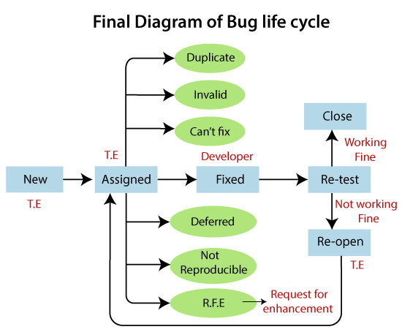
Bug in Software Testing
Bug Life cycle: Another status of the bug:

Slide 12
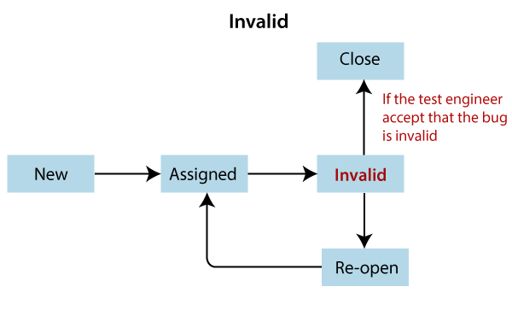
Bug in Software Testing
Bug Life cycle: Another status of the bug:
Invalid / rejected:
When the Test Engineer wrote an incorrect Bug Report because of misunderstanding the requirements, then the Developer will not accept the bug, and gave the status as Invalid and sent it back. (Sometime Developer can also misunderstand the requirements).
Reasons for an invalid status of the bug
Test Engineer misunderstood the requirements
Developer misunderstood the requirements

Slide 13
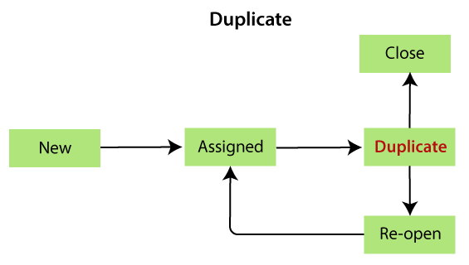
Bug in Software Testing
Bug Life cycle: Another status of the bug:
Duplicate:
When the same bug has been reported multiple times by the different test engineers are known as a duplicate bug.
Reasons for the duplicate status of the bug
Common features
Dependent Modules

Slide 14
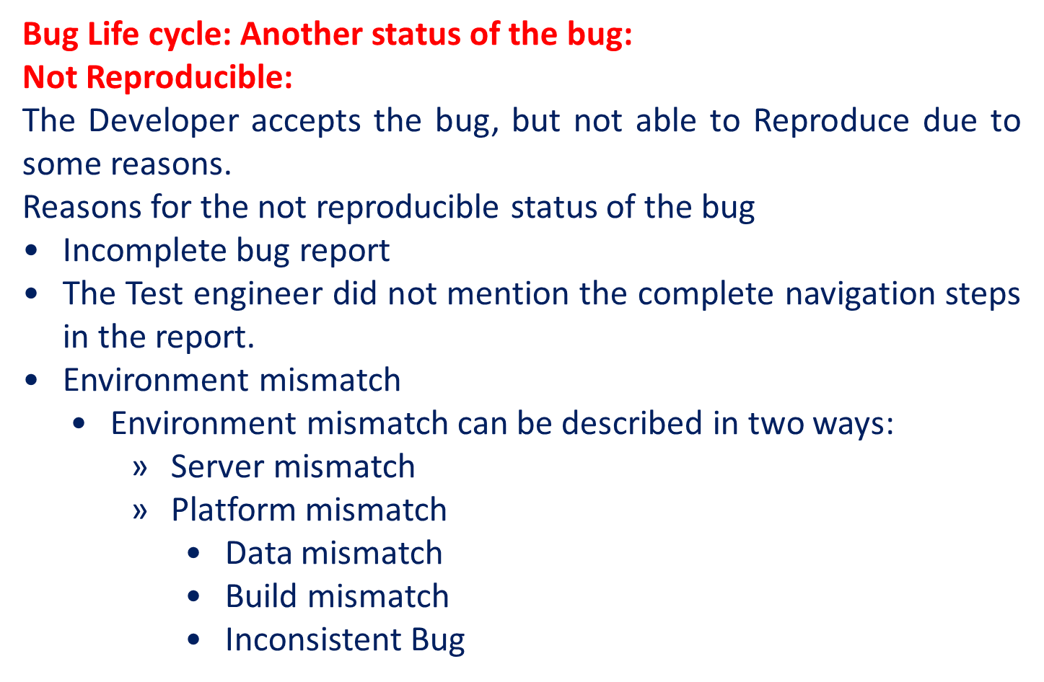
Bug in Software Testing

Slide 15
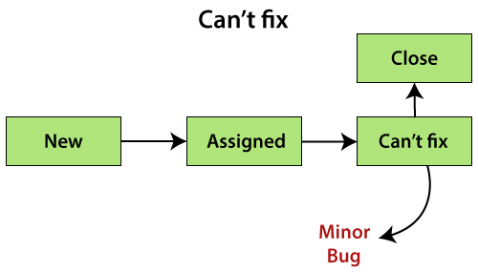
Bug in Software Testing
Bug Life cycle: Another status of the bug:
Can't fix:
When Developer accepting the bug and also able to reproduce, but can't do the necessary code changes due to some constraints.
Reasons for the can't fix status of the bug
Following are the constraints or reasons for the can't fix bug:
No technology support
The Bug is in the core of code (framework)
The cost of fixing a bug is more than keeping it.

Slide 16
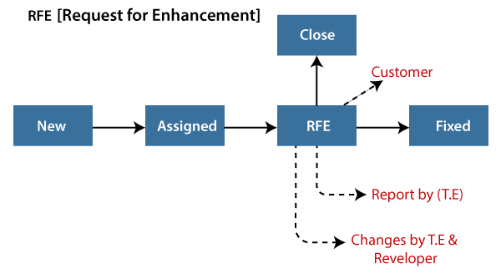
Bug in Software Testing
Bug Life cycle: Another status of the bug:
Deferred / postponed:
The deferred/postpone is a status in which the bugs are postponed to the future release due to time constraints.
RFE (Request for Enhancement):
These are the suggestions given by the test engineer towards the enhancement of the application in the form of a bug report. The RFE stands for Request for Enhancement.

Slide 17
Bug in Software Testing
Bug Life cycle: Another status of the bug:
Deferred / postponed:
The deferred/postpone is a status in which the bugs are postponed to the future release due to time constraints.
RFE (Request for Enhancement):
These are the suggestions given by the test engineer towards the enhancement of the application in the form of a bug report. The RFE stands for Request for Enhancement.

Slide 18
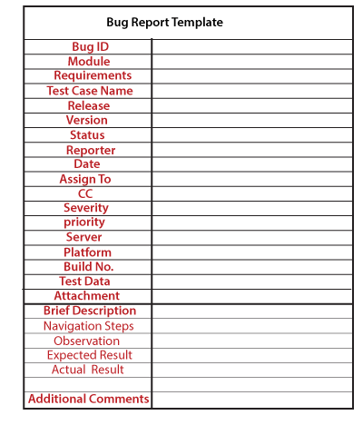
Bug in Software Testing
Bug Report Template (excel):

Slide 19
Bug in Software Testing
Bug Report Template (excel):
Bug ID | Boo12
Module | Login
Requirement | 1
Test case name | Gmail_login_compose _mail
Reporter | Test engineer name
Release | delta
Version | 3.0
Status | assigned
Date | 23-02-2020
Assign to | YY developer
CC | Test lead, developer
Severity | critical
Priority | P2
Platform | Window XP, internet explorer7.0
Build no. | B02
Test data | Username=xyz, password= 123
Brief description
Navigation steps | Login Gmail application Compose mail and confirmation message should be displayed
observation Mail | not found in inbox
Expected result Mail | should also be in the inbox.
Actual result | Mail not found in inbox
Additionalcomments | ------

Slide 20
Bug in Software Testing
Bug Report Template (excel):
Bug ID: it is a unique number given to the bug.
Test case name: When we find a bug, we send a bug report, not the test case to the concerned developer. It is used as a reference for the test engineer.
Severity: It is the impact of a bug on the application. It can be a blocker, critical, major, and minor.
Priority: In this, we have to decide which bug has to be fixed first. It could be P1/P2/P3/P4, urgent, high, medium, and low.

Slide 21
Bug in Software Testing
Bug Report Template (excel):
Status: The different status of the bug which could be assigned, invalid, duplicate, deferred, and so on.
Reporter: In this, we will mention the name of the person who found the bug. It could be the test engineer, and sometime it may be a developer, business analyst, customer, etc.
Date: It provides the date when the bug is found.
Release/Build Version: It provides the release number in which the bug occurs, and also the build version of the application.

Slide 22
Bug in Software Testing
Bug Report Template (excel):
Platform: Mention the platform details, where we exactly find the bug.
Description: In this, we will explain the navigation steps, expected and actual results of the particular bug.
Attachments: Attach the screenshots of the bug, which we captured because it helps the developers to see the bug.

Slide 23
Bug in Software Testing
Severity and Priority in testing:
Severity:
The impact of the bug on the application is known as severity.
It can be a blocker, critical, major, and minor for the bug.
Blocker: if the severity of a bug is a blocker, which means we cannot proceed to the next module, and unnecessarily test engineer sits ideal.
There are two types of blocker bug, which are as follows:
A major feature is not working: Login to HDFC, amount transfer is not working
The major flow is not working: Login and signup itself not working in HDFC application.

Slide 24
Bug in Software Testing
Severity and Priority in testing:
Severity:
Critical: if it is critical, that means the main functionality is not working, and the test engineer cannot continue testing.
Major: if it is major, which means that the supporting components and modules are not working fine, but test engineer can continue the testing.
Minor: if the severity of a bug is major, which means that all the U.I problems are not working fine, but testing can be processed without interruption.

Slide 25
Bug in Software Testing
Severity and Priority in testing:
Priority:
Priority is important for fixing the bug or which bug to be fixed first or how soon the bug should be fixed.
It can be urgent, high, medium, and low.
High: it is a major impact on the customer application, and it has to be fixed first.
Medium: In this, the problem should be fixed before the release of the current version in development.
Low: The flow should be fixed if there is time, but it can be deferred with the next release.

Slide 26
Defect Management Process
The defect management process is the core of software testing. Once the defects have been identified, the most significant activity for any organization is to manage the flaws, not only for the testing team but also for everyone involved in the software development or project management process.
As we know, defect prevention is an effective and efficient way to decrease the number of defects. The defect prevention is a very cost-effective process to fix those defects discovered in the earlier stages of software processes.
The Defect Management Process is process where most of the organizations manage the Defect Discovery, Defect Removal, and then the Process Improvement.

Slide 27
Defect Management Process
As the name recommends, the Defect Management Process (DMP) manages defects by purely detecting and resolving or fixing the faults.
It is impossible to make a software 100% error or defect-free, but several defects can be declined by fixing or resolving them.
The defect management process primarily focuses on stopping defects, finding defects in the earlier stages, and moderating the effect of defects.

Slide 28
Defect Management Process
The Objective of Defect Management Process (DMP)
The primary objective of DMP is to expose the defects at an early stage of the software development process.
The execution of the defect management process will help us enhance the process and implementation of software.
The defect management process reduces the impact or effects of defects on software.
The Defect management process (DMP) helps us to avoid defects.

Slide 29
Defect Management Process
The Objective of Defect Management Process (DMP)
The main goal of the Defect management process is to resolve or fixing the defects.
The defect management process allows us to provide input for status and progress reports about the defect.
To find the primary cause that how the defect happened and how to handle it.
To provide input, for information related to the release of the defect.

Slide 30
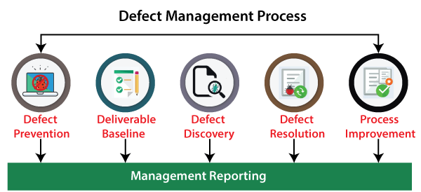
Defect Management Process
Stages of Defect Management Process
The defect management process includes several stages, which are as follows:
Defect Prevention
Deliverable Baseline
Defect Discovery
Defect Resolution
Process Improvement
Management Reporting

Slide 31
Defect Management Process
Stages of Defect Management Process
The defect management process includes several stages, which are as follows:
Defect Prevention
Deliverable Baseline
Defect Discovery
Defect Resolution
Process Improvement
Management Reporting

Slide 32
Defect Management Process
Stages of Defect Management Process
Defect Prevention
The first stage of the defect management process is defect prevention. In this stage, the execution of procedures, methodology, and standard approaches decreases the risk of defects. Defect removal at the initial phase is the best approach in order to reduction its impact.
Because in the initial phase of fixing or resolving defects is less expensive, and the impact can also be diminished.
But for the future phases, identifying faults and then fixing it is an expensive process, and the effects of defect can also be amplified.
The defect prevention stage includes the following significant steps:

Slide 33
Defect Management Process
Stages of Defect Management Process
Defect Prevention
The defect prevention stage includes the following significant steps:
Step1: Estimate Predictable Impact: In this step, if the risk is encountered, then we can calculate the estimated financial impact for every critical occasion.
Step2: Minimize expected impact: When all the critical risk has been discovered, we can take the topmost risks that may be dangerous to the system if encountered and try to diminish or eliminate it.
Those risks that cannot be removed will decrease the possibility of existence and its financial impact.

Slide 34
Defect Management Process
Stages of Defect Management Process
Defect Prevention
Step3: Identify Critical Risk: In defect prevention, we can quickly identify the system's critical risks that will affect more if they happened throughout the testing or in the future stage.
Deliverable Baseline
The second stage of the defect management process is the Deliverable baseline. Here, the deliverable defines the system, documents, or product.
We can say that the deliverable is a baseline as soon as a deliverable reaches its pre-defined milestone.
In other words, we can say that once a deliverable is baselined, any additional changes are controlled.

Slide 35
Defect Management Process
Stages of Defect Management Process
Defect Discovery
The next stage of the defect management process is defect discovery. At the early stage of the defect management process, defect discovery is very significant. And later, it might cause greater damage.
If developers have approved or documented the defect as a valid one, then only a defect is considered as discovered.
As we understood that, it is practically impossible to eliminate each defect from the system and make a system defect-free. But we can detect the defects early before they become expensive to the project.

Slide 36
Defect Management Process
Stages of Defect Management Process
Defect Discovery
The following phases have been including in the defect discovery stage; let's understand them in details:
Phase1: Identify a Defect: In the first phase of defect discovery where we need to find the defects before becoming a critical problem.
Phase2: Report a Defect: The moment testing team identifies a defect, they need to assign known issues to the development team for further evaluation and fixing process.
Phase3: Acknowledge Defect: Once the test engineers' hand over the defect to the assigned developers, now it is the responsibility of development teams to acknowledge the fault and remain further to fix it if the defect is a valid one

Slide 37
Defect Management Process
Stages of Defect Management Process
Defect Resolution
Once the defect discovery stage has been completed successfully, we move to the next step of the defect management process, Defect Resolution.
The Defect Resolution is a step-by-step procedure of fixing the defects, or we can say that this process is beneficial in order to specified and track the defects.
This process begins with handing over the defects to the development team. The developers need to proceed with the resolution of the defect and fixed them based on the priority.

Slide 38
Defect Management Process
Stages of Defect Management Process
Defect Resolution
Once the defect has been selected, the developer sends a defect report of resolution to the test manager's testing team.
The defect resolution process also involves the notification back to the test engineer to confirm that the resolution is verified.
We need to follow the below steps in order to accomplish the defect resolution stage.
Step1: Prioritize the risk: In the first step of defect resolution, the development team evaluates the defects and arranges the fault's fixing. If a defect is more impactful on the system, then developers need to fix those defects on a high priority.

Slide 39
Defect Management Process
Stages of Defect Management Process
Defect Resolution
Step2: Fix the defect: In the second step, the developer will fix the defects as per the priority, which implies that the higher priority defects are resolved first. Then the developer will fix the lower priority defects.
Step3: Report the Resolution: In the last step of defect resolution, the developer needs to send the fixed defects report. As it is the responsibility of development teams to make sure that the testing team is well aware of when the defects are going to be fixed and how the fault has been fixed.
This step will be beneficial for the testing team's perspective to understand the root of the defect.

Slide 40
Defect Management Process
Stages of Defect Management Process
Process Improvement
In the above stage (defect resolution), the defects have been arranged and fixed.
Now, in the process improvement phase, we will look into the lower priority defects because these defects are also essential as well as impact the system.
All the acknowledged defects are equal to a critical defect from the process improvement phase perspective and need to be fixed.

Slide 41
Defect Management Process
Stages of Defect Management Process
Process Improvement
The people involved in this particular stage need to recall and check from where the defect was initiated.
Depending on that, we can make modifications in the validation process, base-lining document, review process that may find the flaws early in the process, and make the process less costly.
These minor defects allow us to learn how we can enhance the process and avoid the existence of any kind of defects that may affect the system or the product failure in the future.

Slide 42
Defect Management Process
Stages of Defect Management Process
Management Reporting
Management reporting is the last stage of the defect management process. It is a significant and essential part of the defect management process. The management reporting is required to make sure that the generated reports have an objective and increase the defect management process.
In simple words, we can say that the evaluation and reporting of defect information support organization and risk management, process improvement, and project management.
The information collected on specific defects by the project teams is the root of the management reporting. Therefore, every organization needs to consider the information gathered throughout the defect management process and the grouping of individual defects.

Slide 43
Defect Management Process
Stages of Defect Management Process
Management Reporting
Management reporting is the last stage of the defect management process. It is a significant and essential part of the defect management process. The management reporting is required to make sure that the generated reports have an objective and increase the defect management process.
In simple words, we can say that the evaluation and reporting of defect information support organization and risk management, process improvement, and project management.
The information collected on specific defects by the project teams is the root of the management reporting. Therefore, every organization needs to consider the information gathered throughout the defect management process and the grouping of individual defects.

